Slide 1
Immigration essentials for independent schools
Tom Brett Young – Partner
@VWVPlus

Slide 2
Agenda
Welcome
Overview of the UK immigration system
UKVI’s approach to Student Sponsor compliance
Confirmation of Acceptance for Studies (CAS) considerations
Living arrangements and safeguarding
Record keeping and reporting duties
Basic Compliance Assessments
Supporting visa applications
Right to Study checks
Unsponsored international pupils
Surviving compliance visits
Top tips for compliance

Slide 3
But before we get started, please tell us about yourself and your school…
Which school are you from?
What’s your role?
Do you sponsor day pupils, or boarders, or both?
Roughly how many CAS does your school assign every year?

Slide 4
UK immigration overview
British citizens, Irish citizens and those with right of abode not subject to ‘immigration control’
EEA nationals subject to immigration control since 1 Jan 2021
Immigration Rules set out requirements for visas, entry, extensions of stay in immigration categories, including:
Visits
Work
Study
Family reunion, protection, Human Rights
Formal process of employer and education provider sponsorship since 2008
Immigration control “outsourced” through Hostile Environment

Slide 5
The Student routes
Student visa (formerly Tier 4 (General)): over 16s studying at independent schools, private and public colleges and universities
Child Student visa (formerly Tier 4 (Child)): the “independent school visa” for students aged 4 to 17
Education provider requires sponsor licence
Assign Confirmation of Acceptance for Studies – “CAS”
Student applies for visa (if overseas) or permission to stay (if in the UK and permitted to do so)
Overseas applicants wait for visa approval; in-country applicants may be able to start studies while waiting for decision

Slide 6
Student & Child Student vs Tier 4
Child Student continues as the “independent school visa” for students aged 4 to 17
Visa applications can be submitted up to 6 months before course starts (3 months for in-country applications)
Expansion of list of ‘differential evidence’ countries
Evidence of finances not needed for in-country extensions

Slide 7
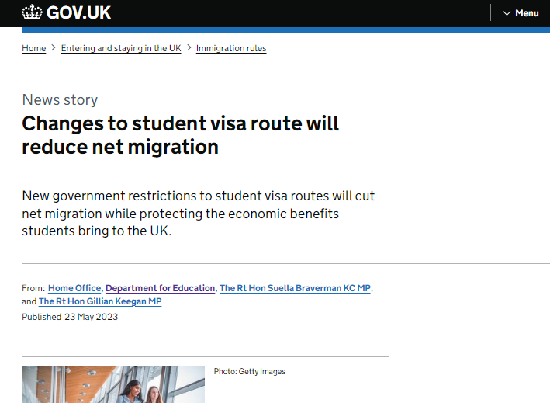
Plans to reduce immigration
May 2023 - ministerial announcement on reforms to Student route:
Government reaffirms its commitment to the International Education Strategy, but…
Series of measures reduce Student visas including restrictions on switching to work categories and ability to bring dependants
Promise of a clampdown on “unscrupulous international student agents who may be supporting inappropriate applications”
Review of maintenance for students and dependants

Slide 8
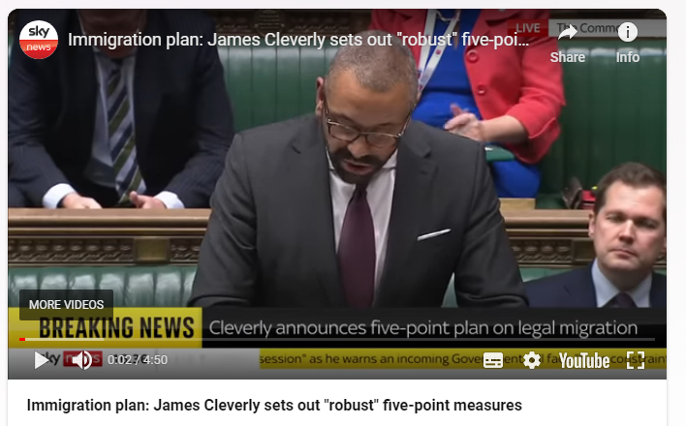
Plans to reduce immigration
December 2023 – “five-point plan” to reduce migration:
Measures primarily focus on work routes
Plan to increase “minimum income requirement” for family visas
Migration Advisory Committee also asked to review the Graduate visa

Slide 9
Student Sponsor compliance – overarching themes

Slide 10
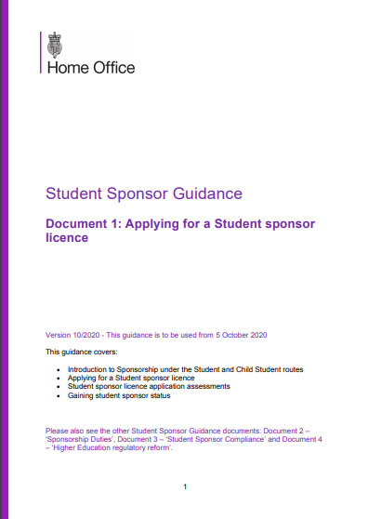
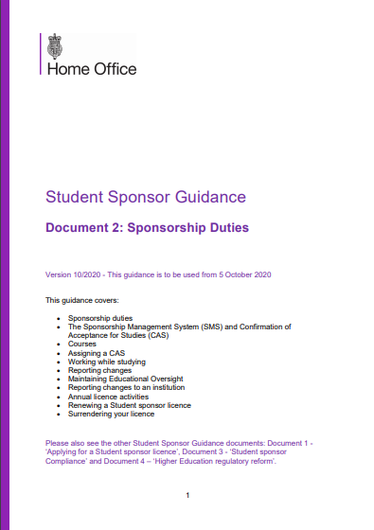
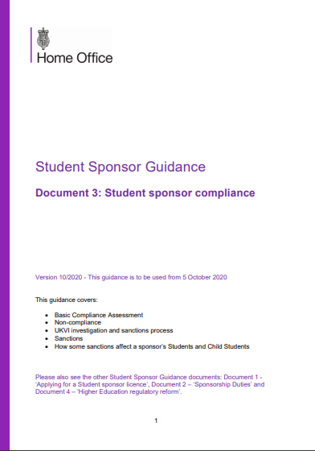
Guidance for sponsors of overseas pupils
www.gov.uk/government/publications/student-sponsor-guidance

Slide 11
Guiding principles
2.1 Sponsorship is a privilege and not a right. Sponsors benefit directly from migration and are expected to play a part in ensuring that the system is not abused. Sponsors must therefore fulfil certain duties, in order to ensure that immigration control is maintained. Providers must be able to show that they can fulfil, and are fulfilling, these sponsor duties in order to gain and retain a Student sponsor licence.
Student Sponsor Guidance: Sponsorship Duties (Document 2)

Slide 12
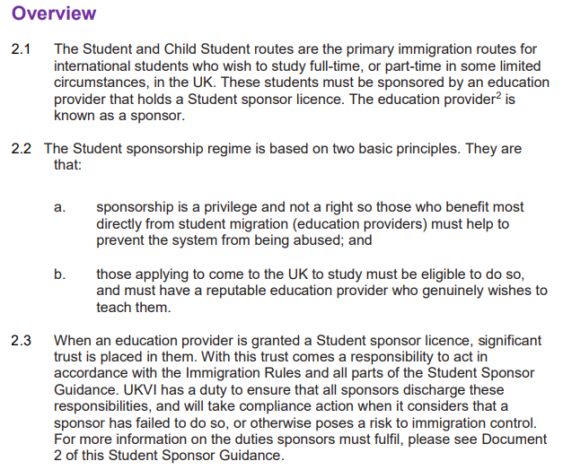
The Student Sponsorship regime
2.1 Sponsorship is a privilege and not a right. Sponsors benefit directly from migration and are expected to play a part in ensuring that the system is not abused. Sponsors must therefore fulfil certain duties, in order to ensure that immigration control is maintained. Providers must be able to show that they can fulfil, and are fulfilling, these sponsor duties in order to gain and retain a Student sponsor licence.
Student Sponsor Guidance: Sponsorship Duties (Document 2)
“It should not be forgotten that under the PBS colleges are performing functions which used to be undertaken by entry clearance officers or other UKBA officials. There is a clear responsibility on those colleges to show that they deserve the trust which is being placed in them.”
R (Western Governors Graduate School) v SSHD (2013)

Slide 13
Plenty of unsuccessful litigation
“There is no need for UKBA to wait until there has been breach of immigration control caused by the acts or omission of a sponsor before suspending or revoking the sponsorship, but it can, and indeed should, take such steps if it has reasonable grounds for suspecting that a breach of immigration control might occur…”
“The Secretary of State is entitled to maintain a fairly high index of suspicion and a ‘light trigger’ in deciding when and with what level of firmness she should act…”
“The courts should respect the experience and expertise of UKBA when reaching conclusions as to a sponsor's compliance with the Guidance, which is vitally necessary to ensure that there is effective immigration control…”
R (The London Reading College Ltd) v SSHD (2010)
R (Westech College) v SSHD (2011)
R (Alvi) v SSHD (2012)
R (New London College Ltd) v SSHD (2013)
London St Andrews College v SSHD (2014)
R (Raj and Knoll Limited) v SSHD (2016)
R (London School of Science and Technology) v SSHD (2017)

Slide 14
Compliance action against Student sponsors
 | Intentions | Revocations | %age
2012-2016 | 1,055 | 713 | 67.6%
2017-2022 | 106 | 46 | 43.4%

Slide 15
Ensuring compliance
Don’t leave it to one person
Think through the ‘pupil journey’ and plan how you will comply with duties at each stage:
Recruitment ○ Visa application
Arrival in the UK ○ Care throughout
UKVI taking a greater interest in safeguarding (parental consent; tracking pupils in/out of school)
Conduct regular reviews:
…of processes
…of records – consider internal audits
…of policies - ensure they take into account issues relating international pupils

Slide 16
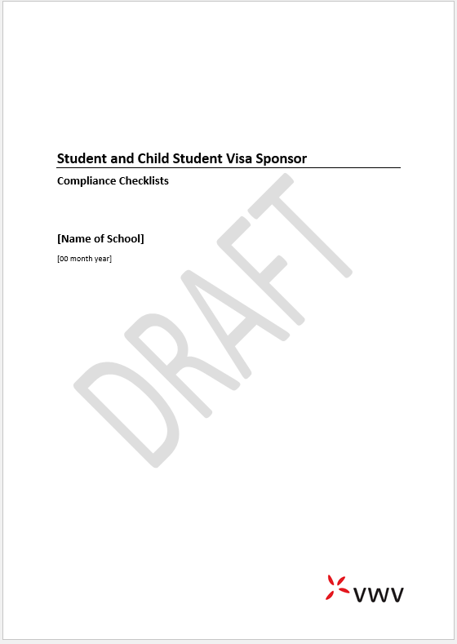
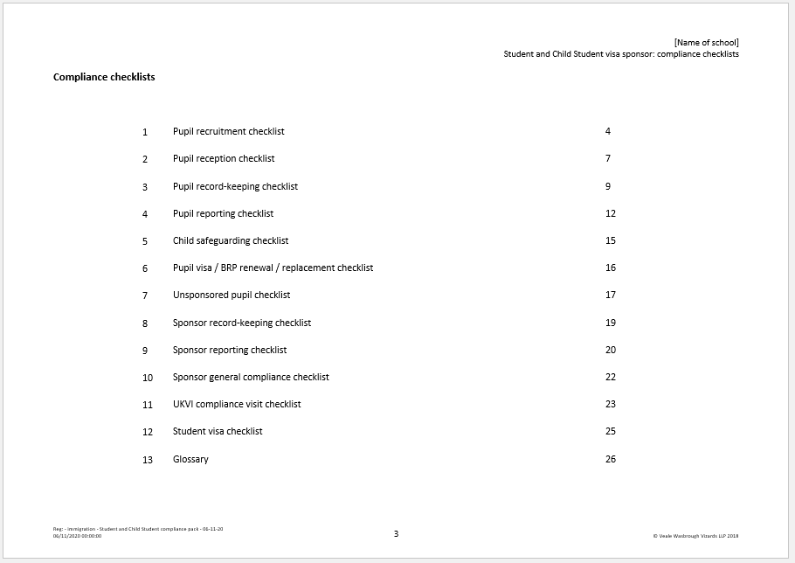
Self-audit – Compliance Checklists

Slide 17
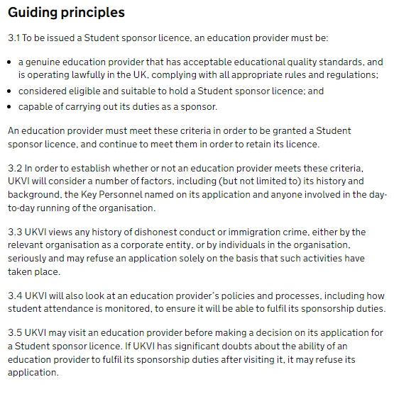
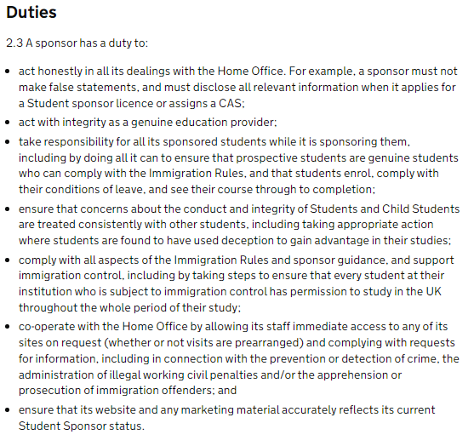
Guiding principle and general duties

Slide 18
Key Personnel
All must be permanently based in the UK and paid members of staff (contracted out Level 1 / Level 2 users also permitted)
Authorising Officer: “most senior person responsible for the recruitment of students and ensuring that all of your sponsor duties are met”; responsible for activities of all users
Key Contact: main point of contact with UKVI
Level 1 users: carries out day-to-day sponsorship activities using the Sponsor Management System – can be more than one; should have enough to cover leave, sickness etc.
Level 2 users: access to SMS but with fewer permissions (assign CAS and student reporting only)

Slide 19
Assigning Confirmation of Acceptance for Studies (CAS)

Slide 20
Assigning a CAS
Common questions:
Child Student vs Student
Pre-sessional courses
Transferring pupils
Supplementary study
Timing of CAS assignment
Fees
www.gov.uk/government/publications/certificates-of-sponsorship-cos-sms-user-manual
Note:
for Child Student CAS, hours should be 0.0
think carefully about what goes in the ‘evidence used to obtain offer’ field

Slide 21
Child Student vs Student
Child Student route | Student route
Aged 4 to 17 | 16 and upwards
Offered unconditional place on a course | Offered unconditional place on a course
Proof of funds (course fees and living costs) | Proof of funds (course fees and living costs)
Study at an independent school | RQF 3 upwards (ie not GCSEs)
Parental consent | Parental consent (16 and 17 year olds)
Up to 6 years study (under 16s) | Restricted to 2 years’ study below degree level after 18th birthday
 | Genuine/credible student interviews
 | English language requirement
 | Academic progression requirement
Genuine student interviews also possible for 16 and 17 year olds
Academic progression exemption must be explained on Student CAS

Slide 22
Pre-sessional courses
A CAS can only cover one course, but pre-sessional courses are the exception
Courses which prepare students for, and directly precede, their intended course of study
For acquiring the ancillary skills or knowledge necessary to adjust to study in the UK – does not have to lead to a recognised qualification
Single CAS may cover pre-sessional course and main course (even if study is with a partner) provided transition to main course is unconditional
Partner must be named on school’s Sponsor Licence
Pre-sessional provider could issue separate CAS

Slide 23
Pupils transferring from other schools
Pupil changing to new sponsor must apply again under Child Student route with CAS from new Sponsor
Cannot start new course until application approved unless:
new sponsor has Student sponsor status
new sponsor has assigned them a CAS
submitted application to UKVI before starting studies and before existing leave expired
But at their own risk

Slide 24
Supplementary study
Supplementary Study permitted, eg evening classes, short courses in vacation periods
Can include study after course detailed on CAS has ended
Can be in any subject and does not have to relate to their main course of study
Must not hinder the Child Student’s progress on their main course of study
If study continues after completion of the main course of study, it must not delay their departure from the UK

Slide 25
Timing of CAS assignment
CAS must be ‘used’ by pupil for a visa/ permission to stay application within 6 months of it being assigned
Visa application can be submitted 6 months before course starts
In-country applications can be submitted 3 months before course starts (start date of new course cannot be more than 28 days after expiry of current visa)
CAS cannot be ‘re-used’ if an application was granted or refused (can be re-used if the previous application was rejected as invalid or withdrawn)
Consider an “enrolment period” (‘latest date a student can be accepted on to the course’ on the CAS)

Slide 26
Fees
Fees paid to date deducted from the amount the family may have to show when submitting the visa application
Fee updates can be added to CAS at any time up to point visa application is submitted
‘Differential evidence’ vs ‘Non-differential evidence’ countries
CAS asks whether you are providing accommodation
Day pupils need additional funds calculated on the basis of their living arrangement:
Private foster care/close relative: £570pcm
With Parent of a Child Student: £1,560pcm (+ £625pcm for each additional child)
£1,023pcm if living ‘independently’ (£1,334 in London)

Slide 27
Living arrangements and safeguarding

Slide 28
Care arrangements for children
Student Sponsor Guidance (Document 2)
3.27 Sponsors who recruit a child under the age of 18 must ensure suitable care arrangements are in place for them in the UK. This must include arrangements for their:
a. travel;
b. reception when they arrive in the UK; and
c. care while in the UK.
2.8 Sponsors of a child under the age of 18 must keep a copy of the letter from the child’s parents or legal guardian […] consent[ing] to the […] application, travel, reception and care arrangements in the UK.

Slide 29
Permissible living arrangements
Boarding
With parent who holds a ‘Parent of a Child Student’ visa
In a private foster care arrangement
Independently (16+ only)
With a close relative who is a UK resident
NB: Financial requirements for visa application vary depending on living arrangement
Parental consent required in all cases

Slide 30
Parent of a Child Student visa
Can be granted to one parent where they have a child attending a UK independent school as a day pupil
Must be at least one child under the age of 12 attending a day school
Older siblings can continue to live with the parent while they hold this visa
Never too early to start thinking about what alternative living arrangements will be in place once youngest child turns 12

Slide 31
Close Relatives and Private Fostering
Carer must be over 18 and “settled”
Close relative = grandparent or step-parent; brother or sister; uncle (brother / half-brother of parent) or aunt (sister / half-sister of the child’s parent)
Private fostering arrangement to be notified to LA before visa application and LA must acknowledge; school to notify LA when child arrives in UK or if the arrangement begins after arrival in the UK
Carer must provide a “letter of undertaking” for visa application
NB: Private fostering arrangements may have arisen during lockdown if boarders stayed with educational guardians for 28+ days

Slide 32
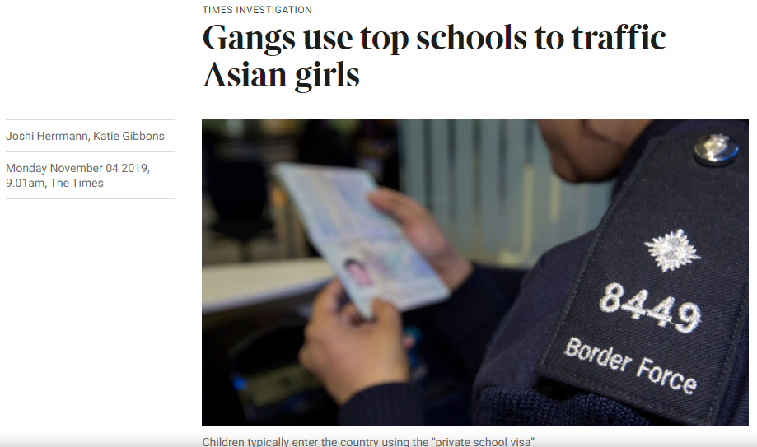
Specific child safeguarding duties
“A sponsor which sponsors children to study in the UK under the Child Student route must ensure that:
appropriate policies and procedures are in place to ensure the safety, wellbeing and protection from exploitation of the children which it sponsors
where a Child Student is [a day pupil], their living arrangements meet the requirements of the route
sites at which children will be taught or accommodated meet all legally required standards for those purposes
all staff who come into contact with the children have a current enhanced Disclosure and Barring Check (England and Wales) […]”

Slide 33
Appropriate policies and procedures
Points to consider including in school policies
Recognise possibility that ‘bad actors’ might try to exploit your licence for trafficking/ exploitation purposes (eg consider references/other due diligence on new agents)
Recognise particular vulnerabilities of children in a different country/culture, with language barriers and no family nearby
Educational guardianship policy to require family to appoint a guardian and set standards (eg age, proximity to school, accredited, not living in a halls of residence(!) etc)
Encourage a culture of openness and transparency where anyone can feel comfortable raising concerns about welfare / child safety / risks of exploitation

Slide 34
Parental consent
Written consent must come from:
both parents; or the legal guardian; or
one parent, if that parent has “sole responsibility”
Sole responsibility:
other parent is unknown or abdicated/abandoned parental responsibility; other parent exercising sole control in setting and providing the day-to-day direction and care for child’s welfare
not the same as sole custody
visa application may be delayed

Slide 35
Other safeguarding considerations
Day pupils:
do the care arrangements meet the requirements of the Immigration Rules?
if living with a parent who holds a Parent of a Child Student visa, what will the care arrangements be after the pupil’s 12th birthday?
Boarders:
what care arrangements are in place during exeats etc?
do they have/need an educational guardian?
obtain updated parental consent where arrangements change
process for recording arrangements for travel to/from school? Are contingencies in place (delayed flights etc.)?

Slide 36
Sponsorship Duties
Record keeping
Reporting

Slide 37
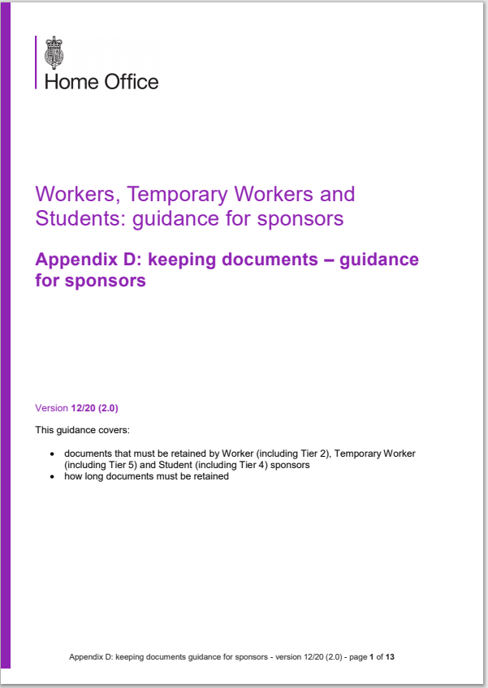
Record keeping
Which records must you keep?
Sponsor Guidance Appendix D - Part 5: for each migrant enrolled under the Student route or Child Student route
How long must you keep them?
Throughout sponsorship and for 1 year afterwards
How must you keep them?
Paper or electronic - no prescribed method, but you must be able to make them available on request

Slide 38
Appendix D part 5
Copy of each sponsored migrant’s current passport, to include:
all pages showing any personal identity details
leave stamps/immigration status document including their period of permission to stay
stamped Tier 4/Student vignette – check entered within validity of vignette
Some students may enter through passport e-Gates, in which case alternative evidence of date of entry is required
NB: If you retain passports for safekeeping, have parents/pupils consented, and are they aware they can have it back at any time?

Slide 39
Appendix D part 5
Copy of document proving each sponsored migrant’s immigration status:
biometric residence permit (BRP) – both sides
digital status (“eVisa” - EEA nationals with biometric passports) accessed using “share code” – print/save PDF of digital status
Record of absences/attendance
Current and historic contact details (UK residential address, telephone number and mobile number)
NB This includes boarders’ contact details during exeats, half-term, etc when spent in the UK

Slide 40
BRPs
90-day vignette – BRP to be collected from Post Office before vignette expires or within 10 days of arrival
Responsible adult to accompany under 18s
With approval (“Standing Authority”), sponsor can collect BRP on pupil’s behalf, but they must take pupil’s passport to the Post Office
Parents cannot collect child’s BRP unless approved (“Responsible Adult” – one week processing), or collecting own BRP and child is named as their dependant
Schools may register as Alternative Collection Location and receive pupils’ BRPs ACL code must be used on visa application
Check conditions: expiry date (NB 31/12/2024), personal details, work restrictions, sponsor licence number… police registration no longer required!

Slide 41
Going digital
Immigration system to become “digital by default”
BRPs all expire on or before 31 Dec 2024
Key part of new system will be the introduction and expansion of the Electronic Travel Authorisation scheme:
Qatari nationals need ETA since 15 Nov 2023; Bahrain, Kuwait, Oman, UAE, Saudi Arabia and Jordan from 1 Feb
Slow roll-out is to ensure airlines can access ETA data at check-in
Goal is for everyone to either have a visa or an ETA before travelling to the UK
Govt to issue instructions to holders of visas due to expire after 31 Dec 2024 on how to create a UKVI account so that they can access and share their eVisas

Slide 42
Appendix D part 5
Day pupils in a private foster care arrangement:
advise local authority of the name of the foster carer and the address where the foster carer and the pupil will be living
also advise LA of new/changed foster care arrangements, as soon as you become aware of them
Retain record(s) of the notification(s) to the local authority
Copies or originals if possible of evidence assessed as part of the process of making an offer to the migrant

Slide 43
The “secret” record keeping duty
Student Sponsor Guidance (Document 2): para 2.8
Sponsors of a child under the age of 18 must keep a copy of the letter from the child’s parents or legal guardian, or just one parent if that parent has sole legal responsibility for the child. This should consent to the arrangements for the child’s application, travel, reception and care arrangements in the UK.
Make sure signed by both parents (or have proof of sole responsibility if signed by just one)

Slide 44
Reporting duties

Slide 45
Reporting duties
A sponsor has a duty to notify UKVI if:
it becomes aware that any of the students it is sponsoring has been granted leave with the incorrect conditions of stay, (eg mistakenly granted permission to work)
anything it has reported through the SMS is incorrect, explaining why it is incorrect
if there are any changes to a Student or Child Student's circumstances
if there are any changes that affect its Student sponsor licence

Slide 46
Reportable changes
Reporting changes to student circumstances
Withdrawals
Start date delayed
Non-enrolment – including visa refusals
10 missing contacts
Deferrals
Cessation of sponsorship
Significant change in student circumstances
Suspicions regarding ‘genuine student’
Delays and deferrals: can the pupil still complete their course without needing a visa extension?
Missing contacts: can define yourself – schools usually use registration. Specify in policy?
Cessation of sponsorship could be because they move into a different immigration category
Significant change? Change in living arrangements?

Slide 47
Reporting changes at the school
Reporting changes affecting your sponsor licence
Changes to Key Personnel
Change address or name
Adding a site/teaching partnership
Change in ownership
Appoint a new principal
Inspection failing
Criminal prosecution/civil penalty issued
Insolvency
Surrendering licence
Convert to an academy
Approval required for some changes (eg adding a site)
Independent schools linked by common ownership/control may be grouped under a single licence, or hold separate licences for each school
Also permitted to hold separate licences for each immigration category
Failed ISI inspection will result in zero CAS allocation until reinspection

Slide 48
Working with overseas agents
Schools must provide UKVI with the details of any third party, in the UK or overseas, which has helped it to recruit students
Schools associated with agents who have been linked to immigration abuse in the past may have their CAS requests curtailed or refused
Are you getting your money’s worth? Do they help with invigilating entrance tests, pupil visa applications, etc.?
Conduct due diligence on new agents
Watch out for signs of trafficking – is the approach from an agent too good to be true?
Don’t bow to pressure to bend your rules/processes
Have a formal agreement in place

Slide 49
Basic compliance assessment

Slide 50
Basic compliance assessment
Annual desk-based review by UKVI of your activities as a Student Sponsor in the 12 months leading up to the application
Must apply by the deadline and pay £536 for the privilege
Visa refusal rate
Less than 10%
10 or fewer CAS, 1 refusal = failure
Enrolment rate
At least 90%
10 visas granted, at least 9 must enrol
Course completion rate
At least 85%
10 students enrol, 2 fail to complete = failure

Slide 51
Course completion
Does not include: pupils who have deferred and left the UK, switching schools or immigration category, left course and left UK
Include details in SMS report
Obtain evidence, e.g. copy of boarding pass
Enrolment
Most school non-enrolments are not ‘no shows’, more likely to be visa refusals, change of mind etc
Stay in touch with parents/agents throughout
Request evidence from pupil and keep on file
Include details in SMS report
Report, even where non-enrolment is due to visa refusal – failure to report is indicator of weakness in process

Slide 52
Visa refusals
Control what you can
Provide guidance for parents
Pay first year’s fees in advance
Bank statements – required info, sufficient funds, date, period etc
Review immigration history
Parental consent letters
Intended carer undertakings
Obtain proof of parental relationship
Check prior to submission

Slide 53
Child Student visa applications
To complete application form applicants need:
CAS number
School’s Sponsor Licence Number
ACL reference
Supporting documents:
Passport
Parental consent letter (plus additional consents for day pupils)
Birth certificate
TB certificate
Proof of finances (non-differential evidence countries)
Translations
EEA nationals: apply using ID verification app – no biometric appointment
Non-EEA nationals: register account with VAC partner; book appointment
Pay Immigration Health Surcharge and application fee (plus priority processing fee if available)
Upload documents
Upload documents; attend biometric appointment, surrender passport
WAIT
Approval: confirmed by email; digital status only (school needs ‘share code’)
Approval: passport endorsed with 90-day vignette; collect BRP following entry to UK
Enter UK after visa validity date

Slide 54
Credibility interviews (16+ students)
The immigration history of the applicant in the UK and other countries
The applicant’s education history, study and post study plans, for example:
whether the course represents academic progression
the credibility of the applicant’s rationale for, knowledge of, and level of research undertaken into, the proposed course of study and sponsoring institution, and living arrangements in the UK
The personal and financial circumstances of the applicant
The qualification, course provider and agents
www.gov.uk/government/publications/points-based-system-student-route

Slide 55
Support for your international pupils
Immigration Manager is a fully automated online system designed to help schools and parents manage the Child Student sponsorship and visa application process.
Designed to ensure schools remain compliant with immigration law. It saves schools valuable time and resources by streamlining document management and includes a visa application pack to guide students and parents every step of the way.

Slide 56
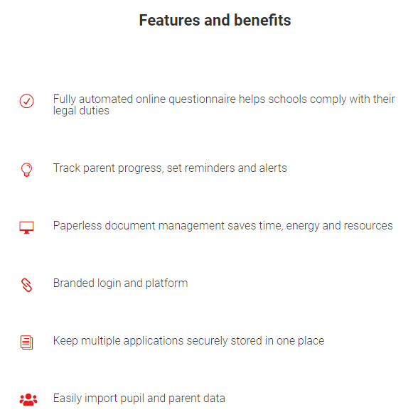
How it works
Im
IM flags any missing documents or potential issues
School assigns the CAS
IM prepares a bespoke visa application guidance pack
Student applies for a visa
Parents complete a dynamic questionnaire on the IM portal

Slide 57
Failing the BCA
UKVI will apply a “discretionary assessment” to independent schools
Will consider:
reasons for visa refusals, failure to enrol, or non-completion
compliance with general duties
compliance history
threat to immigration control?
number of previous BCA failures
(Document 2)

Slide 58
Annual CAS requests
UKVI will review GIAS:
Are you “over-capacity”?
Will the CAS request take you over capacity?
Requests for increases may lead to queries
NB: CAS will be zeroed if school fails an ISI/Ofsted inspection
CAS assigned prior to that point can be used for visa applications
Won’t be reinstated until reinspected and all standards ‘met’

Slide 59
Renewing your sponsor licence
Licences previously valid for 4 years, but any expiring after 6 April 2024 now no longer need to be renewed
If your licence expires before that date, need to renew one last time
Don’t miss the other deadlines!
BCA applications and CAS renewals still need to be submitted annually
Check Authorising Officer and Key Contact details on SMS are up-to-date
Diarise CAS allocation and BCA deadline reminders centrally

Slide 60
Other Student sponsorship updates
NI nos. of your Authorising Officer and Key Contact must be added to the SMS
Sponsors also required to add their Companies House reference no. to the SMS:
CoHo no. of entity named on sponsor register only
Unincorporated entities won’t have a CoHo reference no. to add
Study Sector Support:
Student and Child Student licence holders can now access additional support from UKVI; primarily via the Account Management Portal (AMP)
BRP and eVisa corrections, immigration history, CAS or cancellation queries; telephone support for emergencies involving sponsored students
Fee increases:
overseas visa fee now £490; priority fee increased from £250 to £500; IHS increasing from £470 to £776 per year on 6 Jan 2024

Slide 61
Alternatives to student visas

Slide 62
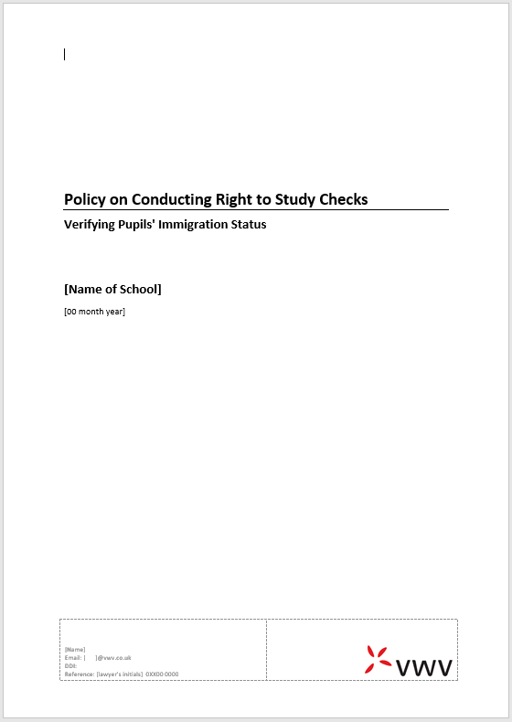
Sponsor duties – non-sponsored pupils
A sponsor has a duty to:
…
comply with all aspects of the Immigration Rules and sponsor guidance, and support immigration control, including by taking steps to ensure that every student at their institution who is subject to immigration control has permission to study in the UK throughout the whole period of their study

Slide 63
Non-sponsored international pupil records
Ensure you record expiry dates
Have a system for alerting you to upcoming expiries
Now needs to include EEA pupils

Slide 64
EEA national pupils
Those here before 1 Jan 2021: entitled to apply under EUSS, although deadline for applications was 30 Jun 2021
EEA national pupils enrolled before 1 Jul 2021: no need for retrospective checks – pupils’/parents’ responsibility to ensure that they applied
Enrolled on or after 1 July 2021?
sponsors expected to check immigration status of EEA nationals (pre- or settled status or something else)
A Certificate of Application confirming that a valid EUSS application has been submitted is acceptable
EEA nationals with “chipped” (biometric) passports will have digital immigration status

Slide 65
Checking pupil immigration status
Proof of status might be confirmed on:
British / Irish passport
Otherwise satisfying yourself that a student is a British or Irish citizen
Vignette endorsed in passport (but usually only valid for 90 days)
BRP
Online status on GOV.UK (need “share code”)
See VWV “Right to Study” policy
NO NEED FOR A CAS WHERE PUPIL HAS THEIR OWN VISA

Slide 66
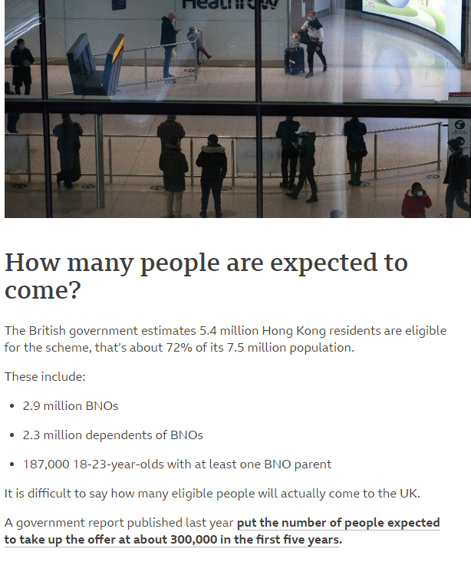
Hong Kong BN(O) Route
British National (Overseas) citizens
Family members including:
Adult children born after 1 Jul 1997 plus spouse if they live with BN(O) citizen
Other dependent family members who live with BN(O) citizen
Source: BBC News

Slide 67
Ukraine Family Scheme and concessions
Ukraine Family Scheme
Joining or accompanying UK-based family members (British, ILR, EUSS or refugee)
Immediate family members, extended family members and immediate family of extended family members
Free of charge – but requires an application and biometric enrolment
Three-year visa – work, study, claiming public funds all permitted
Homes for Ukraine Scheme – as above but sponsored by members of the public
Ukraine Extension Scheme
As above, for Ukrainians in the UK with permission on or before 18 Mar 2022 or permission that expired after 1 Jan 2022
Also can switch into other categories if they qualify

Slide 68
Study by visitors
Previously: visitors could study for up to 30 days only; study up to 6 months required permission to enter as short-term student
Since 1 December 2020:
short-term student for English language study up to 11 months only
Any visitor may study for up to six months at an “accredited institution”
Only to be used where the pupil is genuinely enrolled on a course of no more than 6 months

Slide 69
Surviving compliance visits

Slide 70
Reasons why UKVI conduct visits
On application for a new licence following a change in ownership; “intelligence”; random?
To check that:
the sponsor is meeting its sponsorship obligations:
do they have the necessary systems etc. in place?
complying with record keeping duties
have all relevant events been reported?
there is no threat to immigration control?
their CAS requests are still justified?
Visits can be conducted with or without notice!

Slide 71
What to expect
Interviews with Key Personnel
UKVI will already have accessed your CAS data, reports and Student visa data so may already have suspicions of breaches…
During the visit they are likely to review:
Pupil files/records (including documents from offer)
SMS reports filed (or not filed)
Attendance monitoring processes
Immigration status of non-sponsored overseas pupils
Pupil tracking and monitoring processes
Processes for conducting right to work checks?

Slide 72
Compliance visit outcomes
Visit will lead to one of the following outcomes:
Status maintained
Allocation of CAS reduced to zero
Issued with a time-limited action plan (£1,476 fee)
Licence suspended (notification of intention to revoke) – 20 working days to respond
Licence revoked (across all categories) – existing sponsored pupils will have leave curtailed to 60 days (or “teach-out” permitted to end of year)

Slide 73
Final thoughts…

Slide 74
Watch out for breaches in other routes
Charity Worker route – eg Gap year Students
Must not be filling a permanent role (includes taking a role that will need to be filled by someone else once the migrant workers has left)
Voluntary fieldwork related to the purpose of the charity
Expenses must comply with NMW Act
Skilled Workers
Sponsored prior to 1 Dec 2020 using a non-compliant Resident Labour Market Test
Not doing the job they have been sponsored to do
Right to work checks not conducted properly

Slide 75
Checklist of common failings
Inadequate checks/monitoring of visas held by non-sponsored overseas pupils
CASs assigned covering 2 courses
Concerns about care (and travel/reception) arrangements
Failure to obtain parental consent letters
Not reporting pupils who left before course ended
Failure to report non-enrolments due to visa refusals
Pupil transferring from another school and starting studies before CAS assigned or permission to stay application submitted
SMS users sharing passwords
Failures in other Routes/Categories
Failure to report agents to UKVI

Slide 76
Final tips
Don’t reinvent the wheel – unless you have to!
Think through the ‘pupil journey’: how you will obtain the required documents and comply with your record keeping and reporting duties at each stage?
UKVI expect all Key Personnel to understand their responsibilities and the systems/processes the school has in place to meet its obligations
AO, if not Level 1 user, should have a basic understanding of systems and processes
Review processes regularly – self audit
Don’t do it alone!

Slide 77
Get in touch
Tom Brett Young
Partner
07393 148 352
tbrettyoung@vwv.co.uk
@VWVPlus

